Slide 1

Universal Application Development on Windows Platform for Beginners Module 3: Page Navigation
Dmitry Soshnikov
dmitryso@microsoft.com | twitter.com/shwars | blog.soshnikov.com
Microsoft

Slide 2
Adding New Page to the Application
Project –> Add New Item -> Empty Page
To navigate to the new page, use:
Frame.Navigate(typeof(NewPage));

Slide 3
Passing parameters to the new page
When navigating a page, you can pass an arbitrary object as a parameter:
MyObject MyObj = ...
Frame.Navigate(typeof(DetailPage), MyObj);
protected override void OnNavigatedTo( NavigationEventArgs e)
{
base.OnNavigatedTo(e);
var MyObj = e.Parameter as MyObject;
if (MyObj == null)
throw new Exception("PANIC!");
}

Slide 4
Data between pages can also be passed
Via DataModel
Changes on one page affect the data displayed on the other
Via Application settings
Via File storage
Via Static class
Singleton pattern
…

Slide 5
DEMO 01: Weather Forecast with Details

Slide 6
Handling Back Navigation

Slide 7
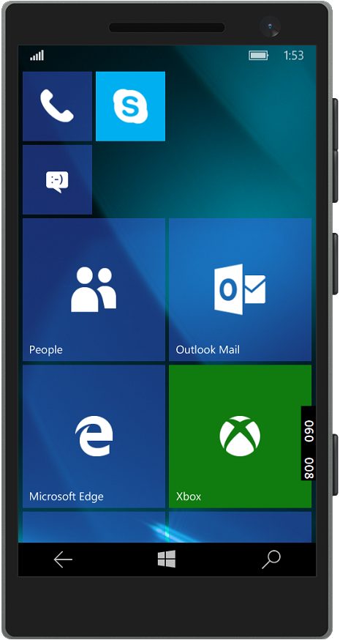
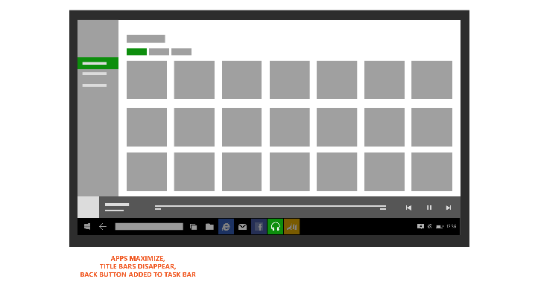
Mobiles and Tablets have software Back button

Slide 8
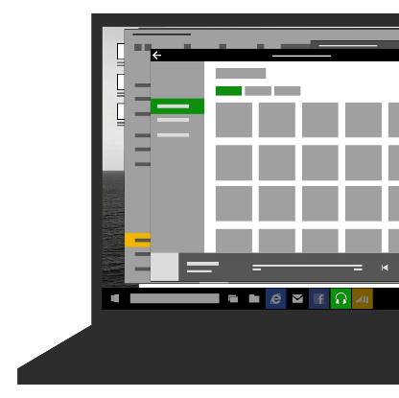

Desktop Applications can use
Standard button on the application title bar
Manually added Back button

Slide 9
Using Standard Back Button
If navigation back is not possible – it is a good idea to hide Back button from application top
This logic can be implemented in App.xaml.cs:
protected override void OnLaunched(LaunchActivatedEventArgs e)
{ …
rootFrame.Navigated += RootFrame_Navigated;
}
private void RootFrame_Navigated(object sender,
NavigationEventArgs e)
{
Frame rootFrame = Window.Current.Content as Frame;
var nav = SystemNavigationManager.GetForCurrentView();
nav.AppViewBackButtonVisibility = rootFrame.CanGoBack
? AppViewBackButtonVisibility.Visible :
AppViewBackButtonVisibility.Collapsed;
}

Slide 10
Implementing Back Navigation
Pressing Back button should take us to the last page of the application, and then to the previously displayed application
The same logic, as in Windows Phone 8.1
Backing out of the application does not close it, but suspend
For tablet mode with split screen two navigation stacks are maintained

Slide 11
Handling Back
Back navigation logic can also be conveniently placed in App.xaml.cs:
protected override void OnLaunched(LaunchActivatedEventArgs e)
{ …
SystemNavigationManager.GetForCurrentView().BackRequested +=
App_BackRequested;
}
private void App_BackRequested(object sender,
BackRequestedEventArgs e)
{
if (!e.Handled) {
Frame frame = Window.Current.Content as Frame;
if (frame.CanGoBack) {
frame.GoBack();
e.Handled = true;
}
}
}

Slide 12
DEMO 02: Handling Back

Slide 13
Manipulating App Window

Slide 14
Manipulating Application Window
Setting min size of the window:
ApplicationView.GetForCurrentView()
.SetPreferredMinSize(new Size(500, 500));
Setting current size of the window:
ApplicationView.GetForCurrentView()
.TryResizeView(new Size(500, 500));
Goind fullscreen:
ApplicationView.GetForCurrentView()
.TryEnterFullScreenMode();

Slide 15
DEMO 03: Window Manipulation

Slide 16
Multi-Windowed Applications
Several windows in Desktop mode or Split View in full-screen mode
Windows.ApplicationModel.Core .CoreApplication.CreateNewView()
Windows.UI.ViewManagement .ApplicationViewSwitcher.TryShowAsStandaloneAsync()
Windows.UI.ViewManagement .ApplicationViewSwitcher.SwitchAsync()
Available on all device types!

Slide 17
DEMO 04: Multi-Windowed Application

Slide 18
Conclusion
Application can consist of several pages
Each page is described separately using XAML+ C#
Use Frame.Navigate to navigate between pages, optionally passing parameter
You need to take care of correct back navigation, or use template which handles it
Multi-windowed application can have multiple windows, each of which loads its own Frame

Slide 19

Contact
Dmitry Soshnikov
Microsoft
dmitryso@microsoft.com & vk.com/shwars
blogs.msdn.com/sos & blog.soshnikov.com
twitter: @shwars

